Slide 1
MTG Discord Ability App
By Team Disharmony (Marc Bienkowsi)

Slide 2
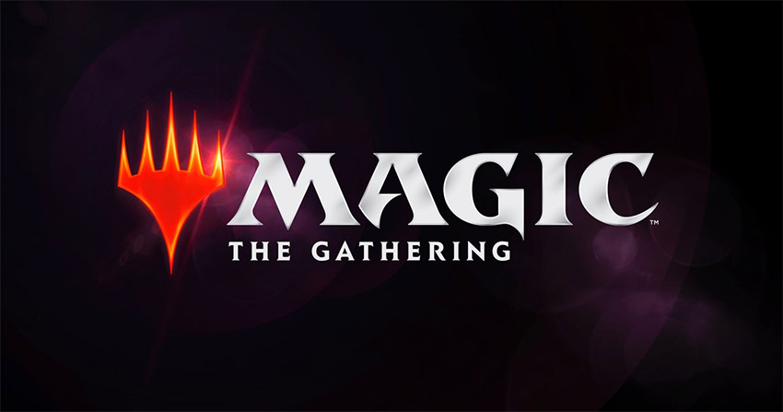
Background-
Designed in to make MTG games more efficient
Is a mobile app designed to be used on the go
Niche solution to a Niche problem

Slide 3
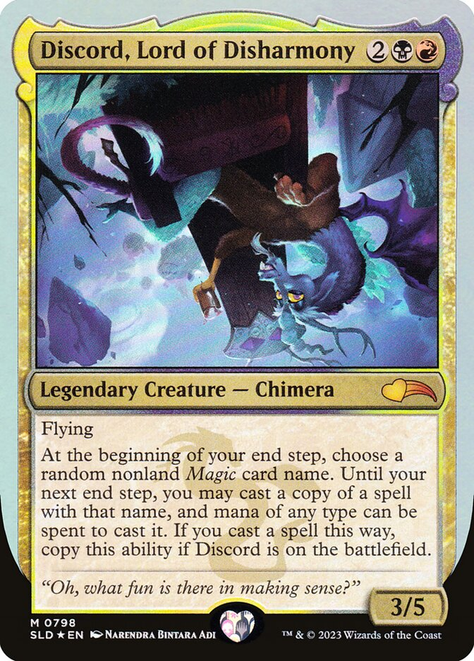
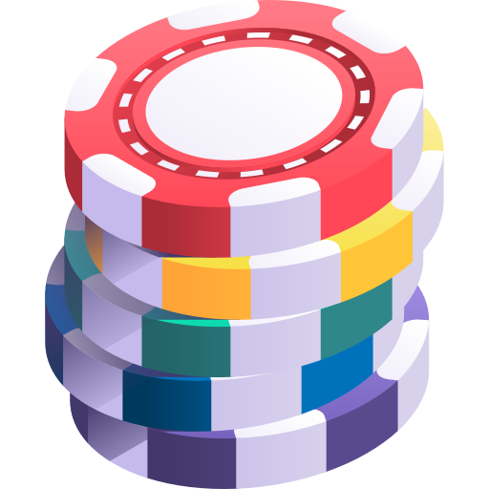
How it will be used-
Basically, just gambling from 27,695 cards to choose from
At end of turn, gain access to play a random card in the game
Ability is recursive

Slide 4
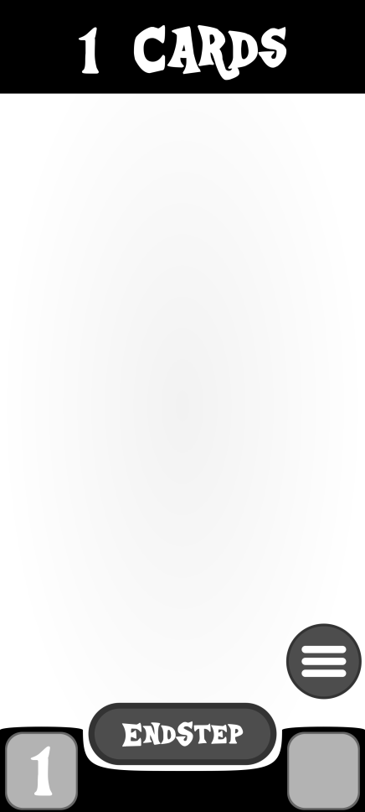
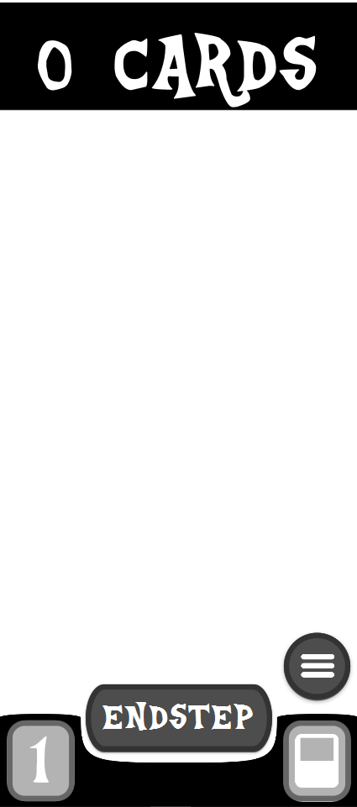
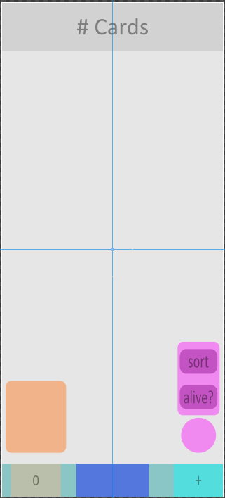
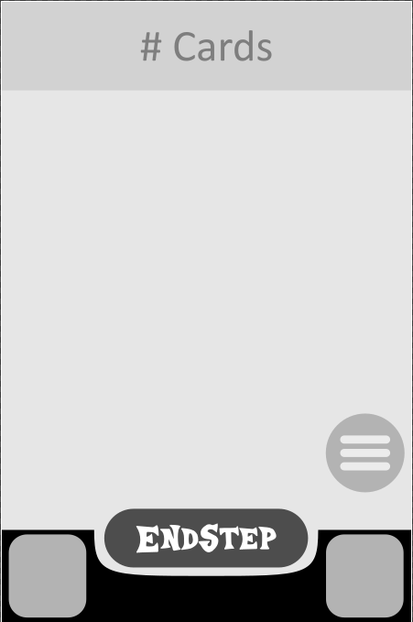
Design-
FINAL

Slide 5
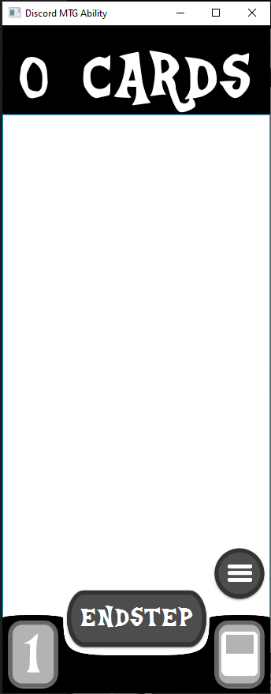
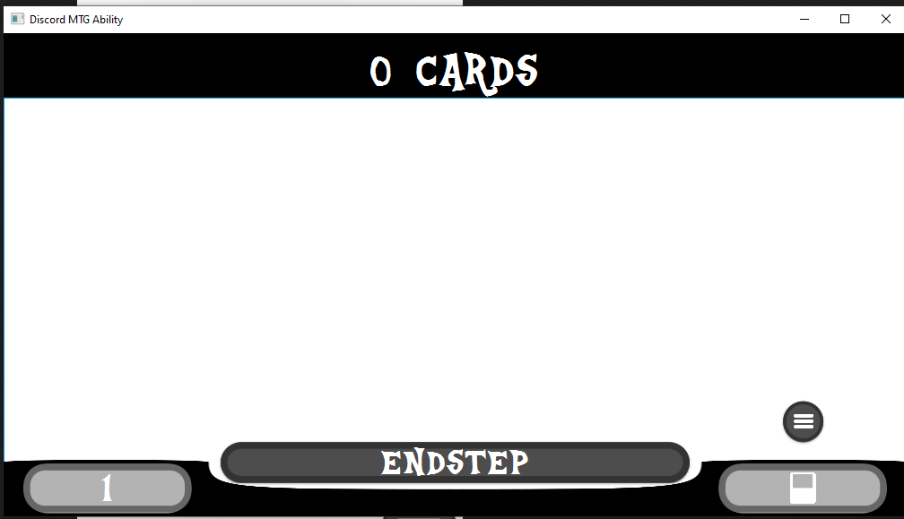
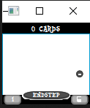
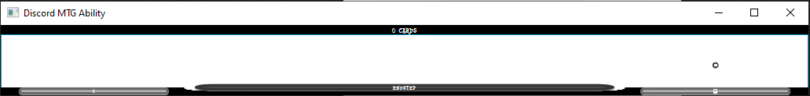
Everything is Resizable-
Because mobile…

Slide 6
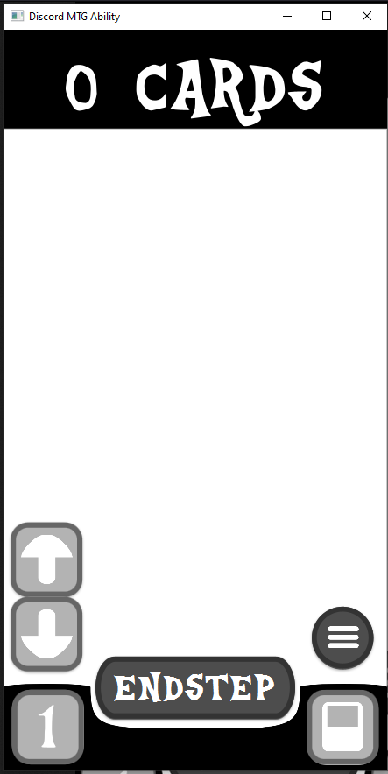

How to Use-
Available card count
Increase endstep
card count (menu)
Discord state (defaulted on battlefield)
endstep
card count
(click to open menu)
Switch to card log scene

Slide 7
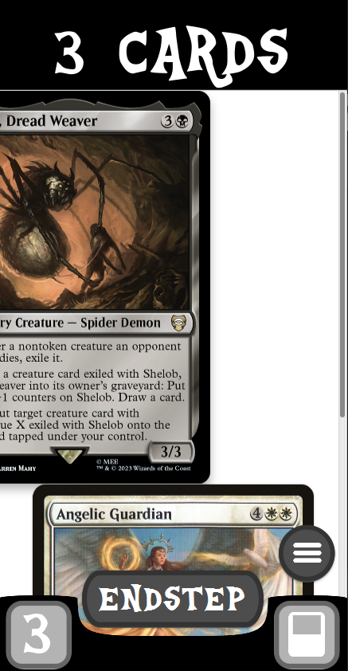
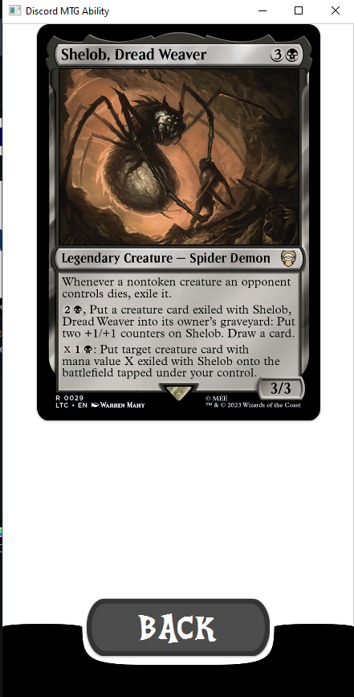


Casting (Swiping)
Card log example
Swipping left “casts” a spell to move it into the card log
(Most recent cards at stacked on top)

Slide 8
Thanks for listening
It might not have made sense, but what fun is there in making any sense?

